Slide 1

MICA team:
Mike Jackson, Inder Grang, Chris Conner , Abby Kannappan
NFL Quarterback Analysis
Drafts from 2000- 2015

Slide 2
Problem Statement
Does drafting a quarterback high in the draft provide teams a better chance at success?
How do stats compare amongst them and do they make a difference to success?
What are the costs and what is the overall value?
Is there a definitive draft strategy teams should utilize?

Slide 3
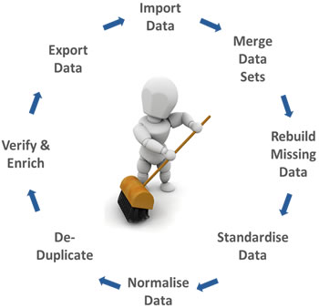
Presentation Outline
Data Sources and Cleansing
Data Evaluation of draft data
Draft round data vs NFL performance metrics
NFL performance statistics vs. Player Salary
Data Outliers
Conclusions

Slide 4
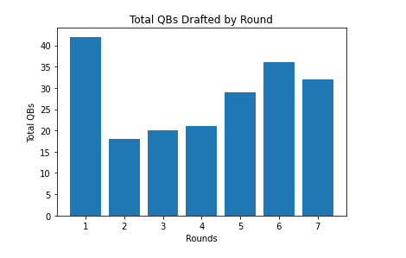
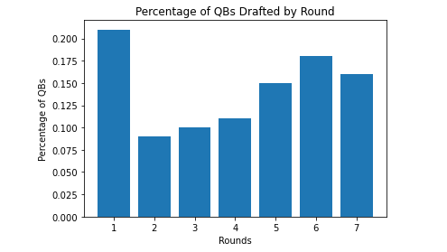
QBs Drafted from 2000 to 2015 Draft Class

Slide 5
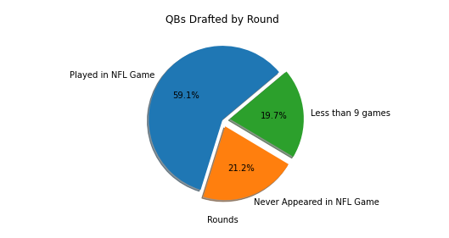
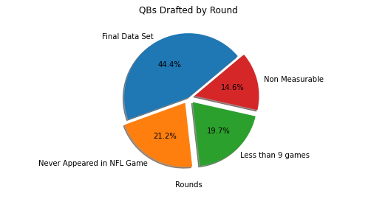
Data Cleanup-Elimination of Non Measurables or Insufficient Data

Slide 6
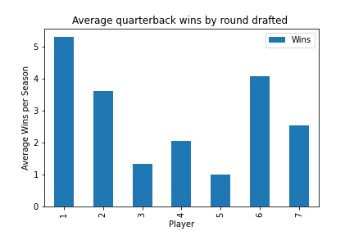
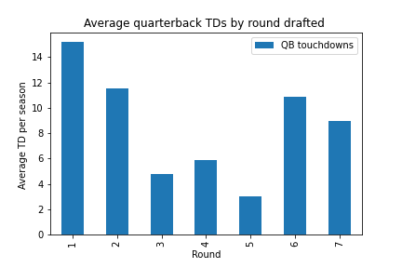
Wins and TDs

Slide 7
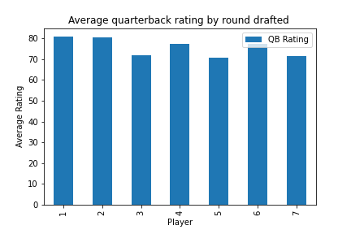
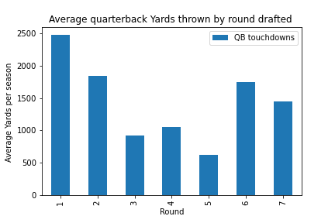
QB rating and Yards

Slide 8
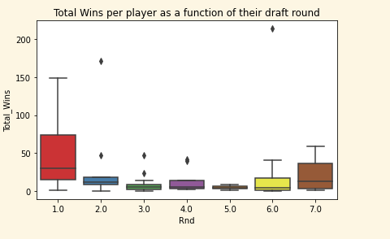
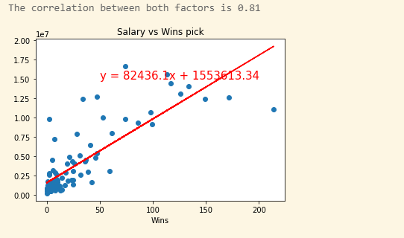
Draft Analysis
First round players had the most wins.
Round 3-5 had least wins
Round 6 and 7 surprisingly had more wins.
Here is a linear regression of salary vs number of wins
Correlation coefficient is 0.81 which means strong Correlation
Most of the players got picked at age 22 or 23.

Slide 9
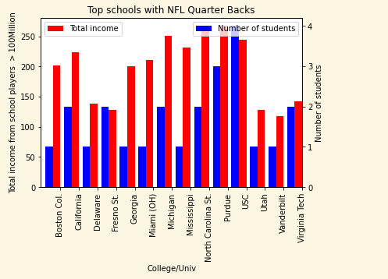
Data Analysis (Colleges/Univ)
USC had the most QB players at 4
Most of the schools only had 1 player

Slide 10
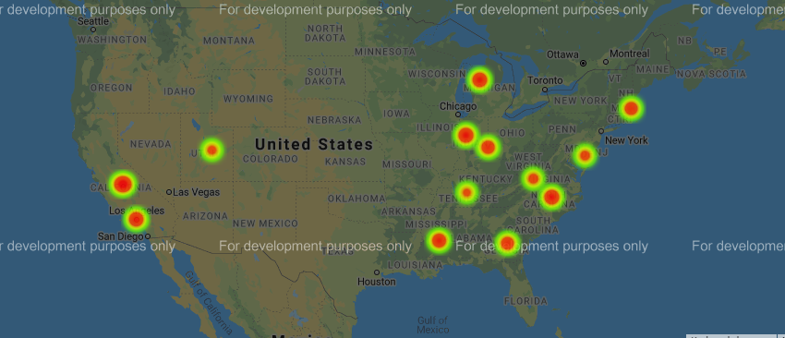
Universities by player salaries
Here is a heat plot of geolocations of different univ (weighted by their players’ salaries)

Slide 11
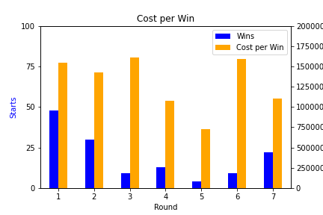
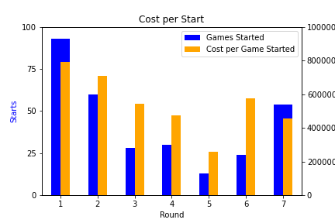

Slide 12
Conclusions
Can’t definitively say which round provides the absolute most value, but there is a clear talent gap drop after round 2.
Whether the motivation is Winning or simply Games Started, there is very little money saved by passing on a first rounder.
Rounds 3-5 provide extremely low value and should be avoided. The odds of finding a “Unicorn” in rounds 6 & 7 are just as likely.

